Slide 1
Follow up, & Call Reluctance Remedies
New daily 3pm c2c’s and jsi drills! WK 27

Slide 2
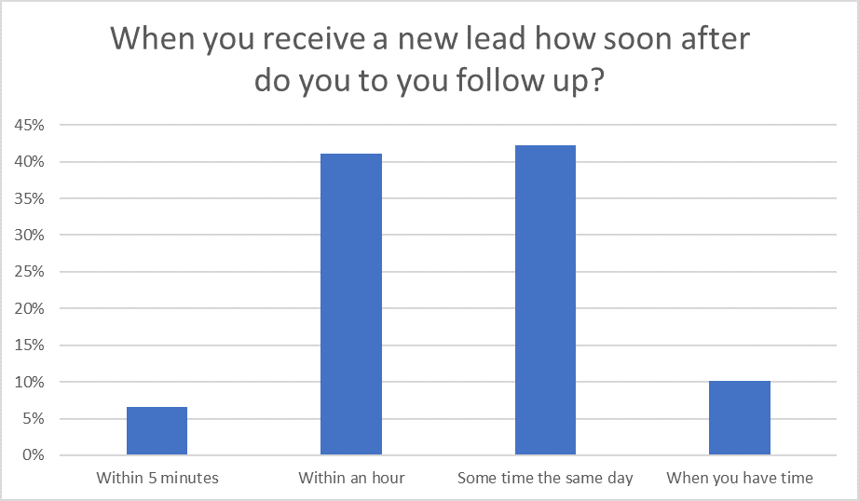
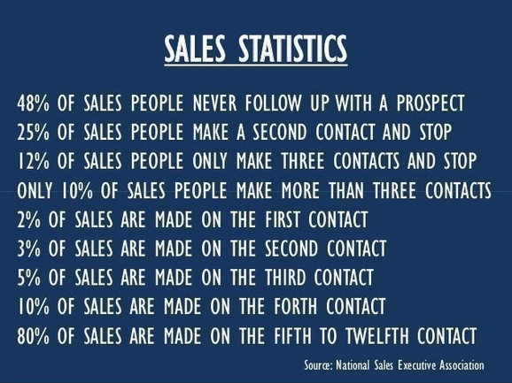
According to a study by Brevet, 80% of sales require an average of five follow-ups in order to close the deal. However, 44% of sales reps follow up with a prospect only once before giving up. After four follow-ups, 94% of salespeople have given up.

Slide 3
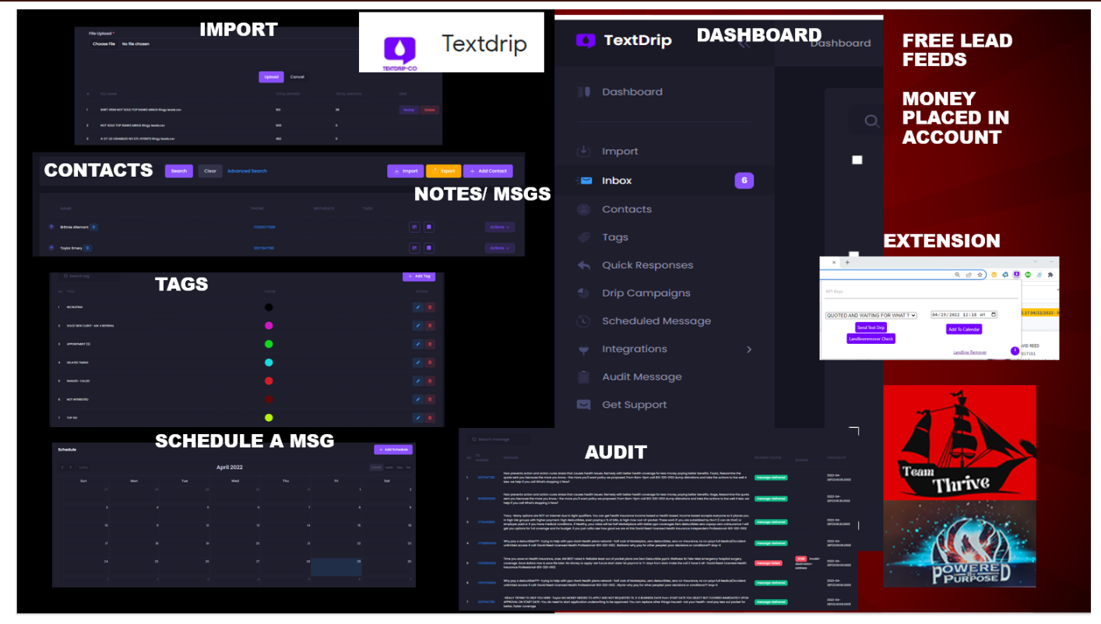

Slide 4
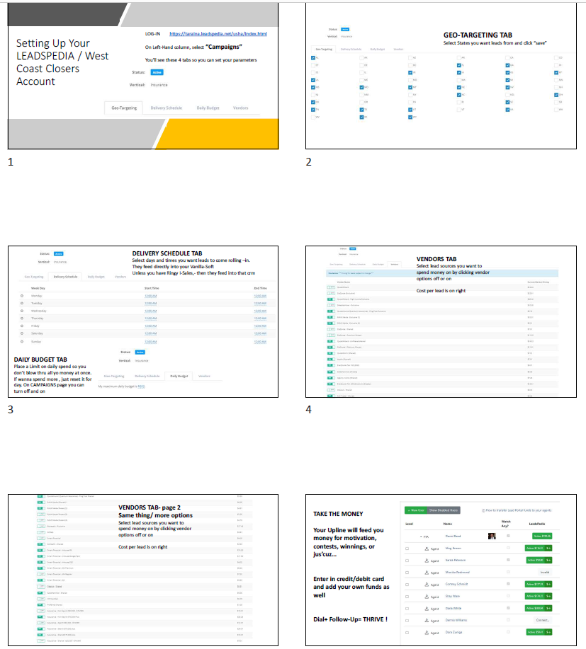

Slide 5
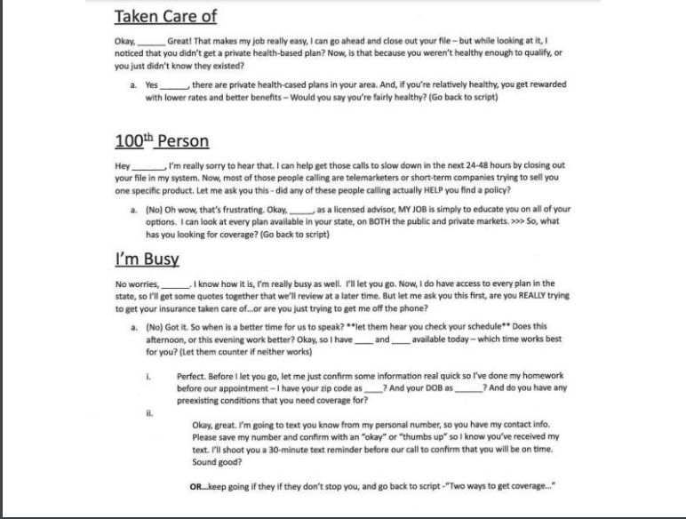

Slide 6
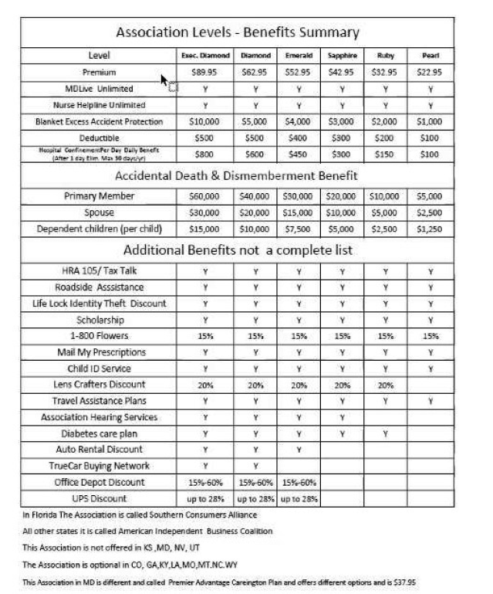
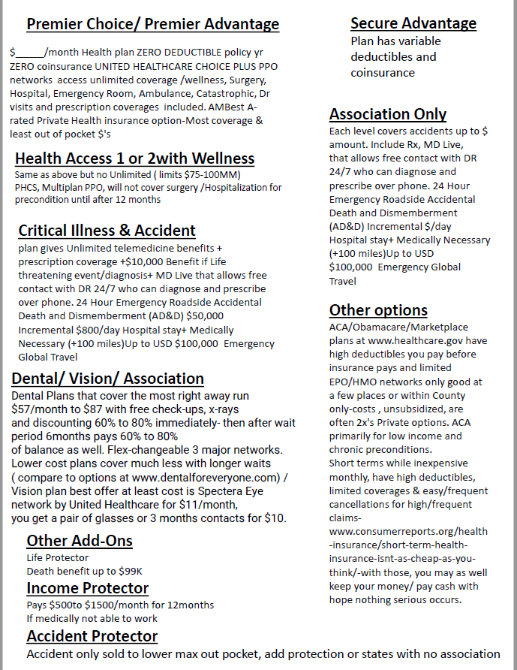

Slide 7
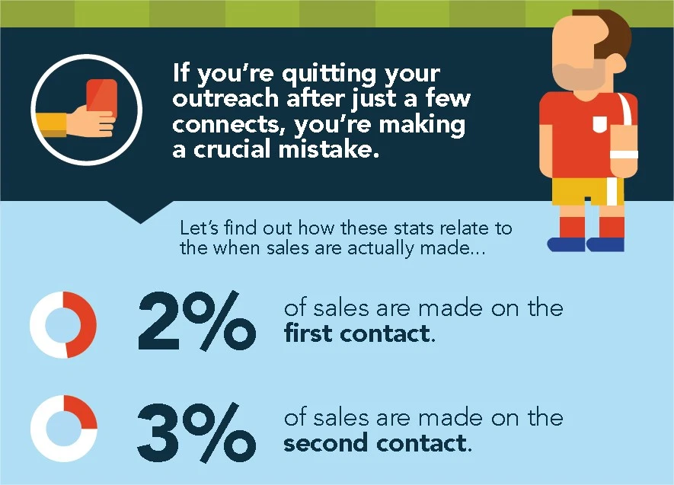
That’s an awful lot of potential sales that are never being closed, and potential revenue that is being left on the table.
Reticence over following up is understandable. Salespeople are very aware that their profession can carry a reputation for being pushy or aggressive. You don’t want to be seen as annoying or not taking the hint, so you simply stop following up.
However, do you know the number one reason why a prospect won’t get back to you? It’s not because they are not interested, it’s because they are busy. Decision makers have a lot of conflicting priorities to juggle and many different demands on their time. According to Harvard Business Review, professionals have on average over 200 emails in their inbox at any one time.
In other words, they’re (probably) not ignoring you because they don’t want what you have to offer.
You just need to be tenacious to get their attention because they have a lot going on. Next -, we’ll learn how to perfect the art of the follow-up.
because they are busy

Slide 8
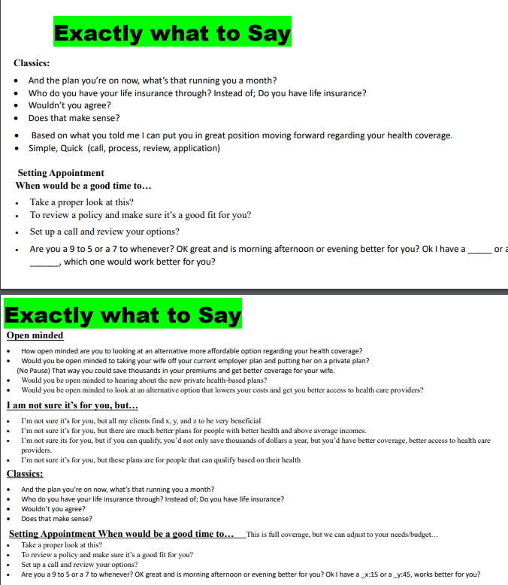
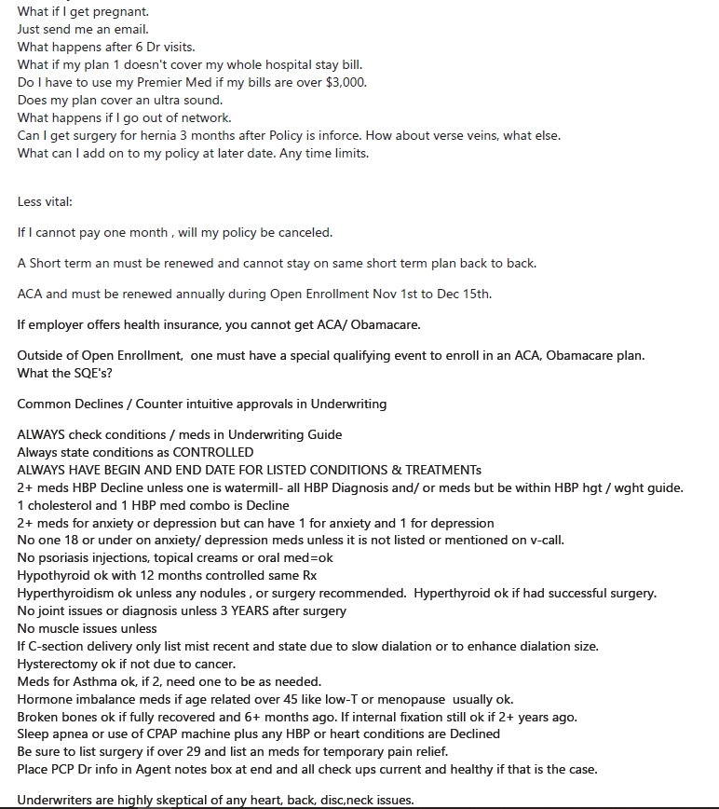

Slide 9
Sales Follow-Up Techniques
1. Use a variety of follow-up methods.
So you’ve sent two or three follow-up emails to your prospect and heard nothing back. It may be time to pick up the phone. Alternatively, if you keep calling and they’re always too busy to speak to you, you might have more luck by sending an email instead.
Don’t stop at just telephone and email, either. Obviously I’m not suggesting you track someone down on every platform you can think of, but if you’re connected on a professional platform such as LinkedIn, there’s no reason you can’t use that to follow up.
In short, if you’re not sure what someone prefers, try different follow-up methods. People prefer different methods of communication, and what gets one person’s attention will go ignored by another.
On the other hand, if someone specifies a particular method of communication, respect that. You won’t endear yourself to a prospect if you keep calling them after they’ve said they like to do all business by email.

Slide 10
2. Space it out.
The quickest way to annoy your prospect and put them off is not following up too many times — it’s spacing your follow-ups too closely together.
Purchasing decisions often move slowly, and even more so when the product or service is of a substantial value. Therefore, you probably cannot expect prospects to make a decision instantly, or even overnight.
This is a major purchasing decision and cannot be rushed. They think they need longer lead times but they DON’T if connect with YOU-so follow up. For those who sell B2B, there are often multiple stakeholders involved in the decision making process.
There’s no exact formula for correctly spacing your follow-ups. In most circumstances, every day is too often, and once a week is not often enough. OTHERS are chasing them relentlessly and YOU must intercept with VALUE + DIFFERENTIATION Three per Day or so is appropriate in most circumstances.
The best thing you can do in terms of spacing out your follow-ups is to understand your prospect’s timeframe. For example, let’s imagine you’ve QUOTED a prospect. They say they will review it before next week. In this situation, following up with them the next day will only annoy them but every other day is fine.
Here’s an extra tip for you: set reminders for yourself on your calendar to ensure you never miss the opportunity to follow up at the right time.

Slide 11
3. Provide value with each follow-up.
Even though you are a salesperson, your prospects don’t want to feel as though they are on the receiving end of an aggressive sales pitch. Hard selling simply does not work any more. Instead, you can get better results by engaging the prospect with each follow-up and ensuring you provide them with value (Professional & Polite).
In other words, it’s not about you or even about your product. It’s about them.
Here are some ways to provide value with your follow-ups:
Begin by asking the prospect if they have questions and what else they are considering— Ideally, you should strive to remember something significant about each prospect. For example, let’s imagine your prospect told you that they were about to start a new business. The next time you speak with them, you should ask how it’s going. Simply remembering things about people and showing that you care helps to build the kind of human connection that drives sales.
Keep notes about the prospect’s pain points and the problems they are trying to solve — Always center the conversation on these pain points and problems. Remember: you’re not just selling a product. You’re selling a solution to a problem.
Include a link to a relevant article, blog post, or video in your follow-up email — The content must relate strongly to the prospect and the problems they’ve told you they are facing. By providing them with useful content, you prove that you are interested in a mutually beneficial relationship as opposed to a quick sale.
Notify them of a different offer or news item on Health— This can be a great way to re-engage with a
Remember that “value” does not have to be financial. You simply need to ensure that you are offering something useful to the person every time you speak to them

Slide 12
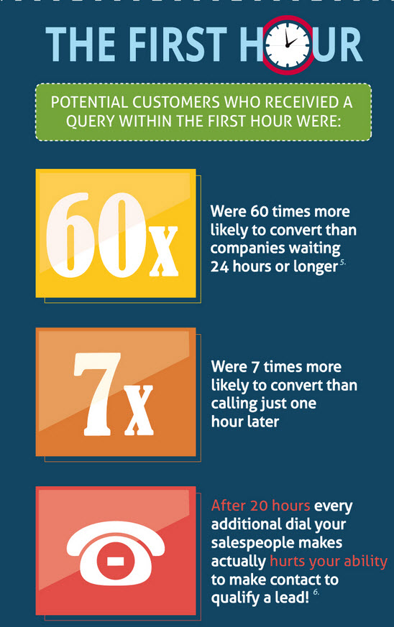
4. Always define the next steps.
One of the biggest follow-up mistakes salespeople make? Not clearly defining the next steps in the process with the prospect.
For example, if the prospect says they need time to discuss your offer with their team, agree to follow up with them a week or two later. If you’ve had a successful discussion and they have expressed interest, arrange another call soon to move things along.
Be as specific as possible. “I’ll call you next week” is vague. “I’ll call you on Wednesday — how’s 9:30 for you?” is much better

Slide 13
5. Subject lines matter.
If you’re following up by email, the subject line can make or break the success of your follow-up. You need to grab their attention enough to make them want to open your email in the first place.
A generic subject line like “Just checking in” or “follow up” won’t cut it. These are easy to ignore or send straight to the trash folder. Instead, you’ll need to craft something enticing that will make them want to know what you have to say.
Perhaps the most important thing to do is personalize your subject line by using the recipient’s name. One study showed that this increased open rates by around 29%:
￼
Here are some other follow-up subject line best practices to be aware of:
Keep it short, to-the-point, and conversational in tone.
Create a sense of urgency. This might include referencing a specific time (e.g., “meeting on Wednesday at 10 am?”), or a quote expires (“Thursdays are Push-Thru days in Underwriting!”)
Ask a direct question. A question like “can you help me out?” or “what do you think about…” can entice the recipient to open the email /text and respond.
Make it clear the text/email contains valuable content. A subject line like, “saw this video and thought of you” or “thought this article might be useful to you” demonstrates value.
Remember that your first hurdle is to get them to open/read your text/email, so take the time to craft an irresistible subject line.

Slide 14
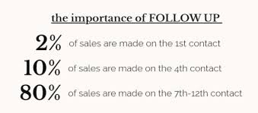
6. Keep it brief.
We discussed, your prospects are busy people. They do not have time for rambling emails, long phone calls, or endless meetings. Instead, cut to the chase and keep your follow-ups brief and to the point.
An email /text follow up should be no more than about six lines in total length. And a follow-up telephone call should generally last no longer than around 7 minutes.
Doesn’t sound very long? That’s because it isn’t. You have only a short timeframe to grab your prospect’s attention and make them want to take action, so be direct.

Slide 15
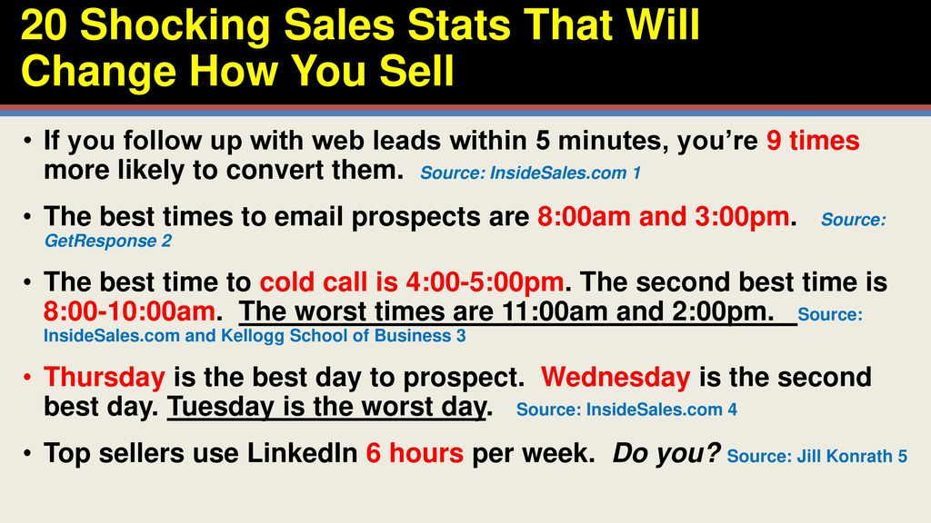
7. Know when to stop.
You can’t keep following up forever. At a certain point, it becomes aggressive, pushy, or just pointless.
When is enough enough? It’s hard to say, because it depends on the circumstances. Some marketers recommend following up endlessly until you receive a definitive response.
Since 80% of successful sales require five follow-ups on average, Recommend using this as your baseline. Certainly send no more than six or seven in total. At a certain point, deliver a break-up notice
I recommend sending one final email before you stop contacting the prospect. This is known as the break-up text/email. If the prospect was interested but hadn’t got around to replying to you, this will spur them into action. If not, you have closed out the pitch and they know not to expect to hear from you again.
It goes without saying that you should stop following up immediately if the prospect comes back with a firm “no” or otherwise indicates a clear lack of interest. Just see if you can learn Why. Continuing to contact them at that point is simply spamming.

Slide 16
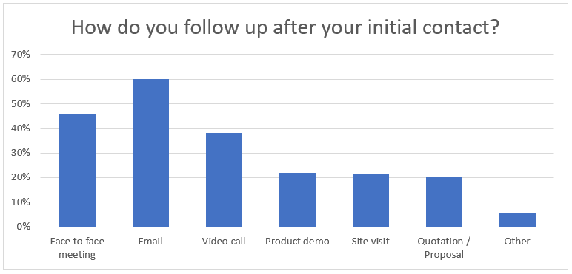
Don’t Be Afraid of Follow-ups
Many salespeople are afraid of the follow-up stage of the sales process. This is because they fear annoying the prospect, being seen as a spammer, or even losing a potential sale due to following up too much.—Shut the Fuck –Up!
You might even be afraid to follow up in case you hear a definite “no.” But here’s something you should understand: a clear “no” is a gift. It means you can cross that prospect off your list, stop wasting time, and move on to someone who is interested in what you’re offering.-not our client
However, failing to follow up is one of the quickest ways to lose up to 80% of your potential sales. That’s an awful lot of revenue you’re not making. Therefore, stop being afraid of the follow-up. It is a crucial part of doing business.
I recommend reframing it in your mind. You’re not following up with the prospect to spam them, annoy them, or pressure them into making a purchase. Instead, you’re being persistent because you have a product or solution that can help them fulfill a need.
If you start to see following up as part of building a relationship with a prospective client, you’ll come to understand its importance and stop being afraid of it. Good luck!

Slide 17
We’ve all been there. You’re about to pick up the phone to dial the next number and reach out to a warm lead -- and then it hits you: A wave of uncertainty and a million different “what-ifs” begin playing in your mind. As this anxiety continues to wash over you, you notice the other salespeople making calls, smiling, and having a wonderful time interacting with their customers.
“How does it come so easily to them?” you ask yourself. Rather than just sitting there and nervously clutching your phone, you decide that, instead of making calls, you should probably go through your CRM one more time to triple-check that all of your contact information is up to date on your leads.
Deep down, you know you should be making calls, but this overwhelming anxiety feels like it’s too much to overcome.
"By understanding the primary factors that fuel your call reluctance, you’re much better equipped to overcome it."
What you’re experiencing in these moments is known as “call reluctance,” a very common, but potentially very career-damaging inhibition that affects many people within the sales profession.
And while call reluctance can feel indomitable, many salespeople just like you have overcome it by understanding its root causes and building a strategy to confidently reach out to customers, authentically connect, and begin building trust-based relationships.
Understanding Sales Call Reluctance and How to Overcome It

Slide 18
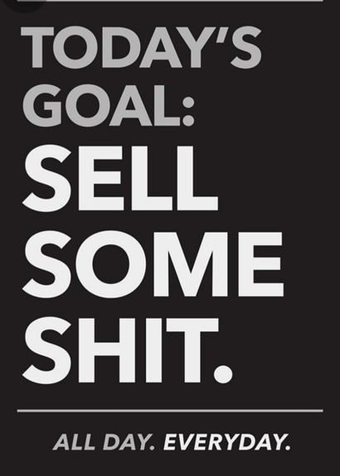
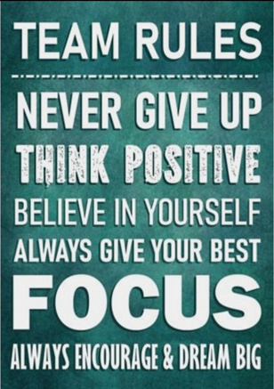

Slide 19

What Causes Sales Call Reluctance?
The root causes of call reluctance vary from salesperson to salesperson, but it often stems from a few common sources. And when you understand the primary factors that fuel your call reluctance, you’re much better equipped to overcome it.
You have a natural fear of rejection.
As humans, we are inherently wired to pursue positive social interactions, group acceptance, and a knowing that we’re contributing to the group. But when we’re rejected -- be it by a customer, prospect, or fellow salesperson -- our biological fear response kicks in and screams at us that we’re of little worth and that we should retreat from the situation.
On a cognitive level, we’re terrified that rejection and the subsequent biological response that we’re feeling are confirming our deepest fears: That we’re bad at sales and are destined to fail.
These thoughts and feelings, working in conjunction with our body’s biological responses, create a toxic brew of panic. And naturally, we want to avoid experiencing these uncomfortable stimuli ever again, making the thought of picking up the phone an anxiety-inducing episode each time.

Slide 20
You’re not properly qualifying your leads.
One of the core tenets of ethical, customer-first sales is recognizing that your role as a salesperson is that of a trusted advisor, and that you are ultimately there to help your customers solve their problems.
However, if you’re not performing the due diligence to first pre-qualify that your product or service is a good fit for your prospect, then you’re doing a disservice to all parties involved. Your prospect could be wasting their time with a product that isn’t of use to them, and you’re expending time and effort that doesn’t result in prospect’s problem being solved.
Placing yourself before prospects that haven’t been properly pre-qualified greatly increases the likelihood of you being rejected, further reinforcing any negative thoughts and feelings you have concerning your ability to sell effectively.
You don’t have a thorough understanding of the value of your product or service.
A deep and up-to-date knowledge of your organization’s products or services is absolutely crucial.
Without it, you’re left looking unknowledgeable should your customers or prospects have a more nuanced question concerning how your offerings might be of use to them. This increases the chances of you being rejected, compounding the existing negative feelings that are fueling your call reluctance.
Additionally, you lack the ability to determine whether or not your product is the correct fit for your prospects’ needs. This greatly hinders your ability to properly qualify your leads, potentially creating more instances of you being rejected by those who don’t truly have a need for your product or service.

Slide 21
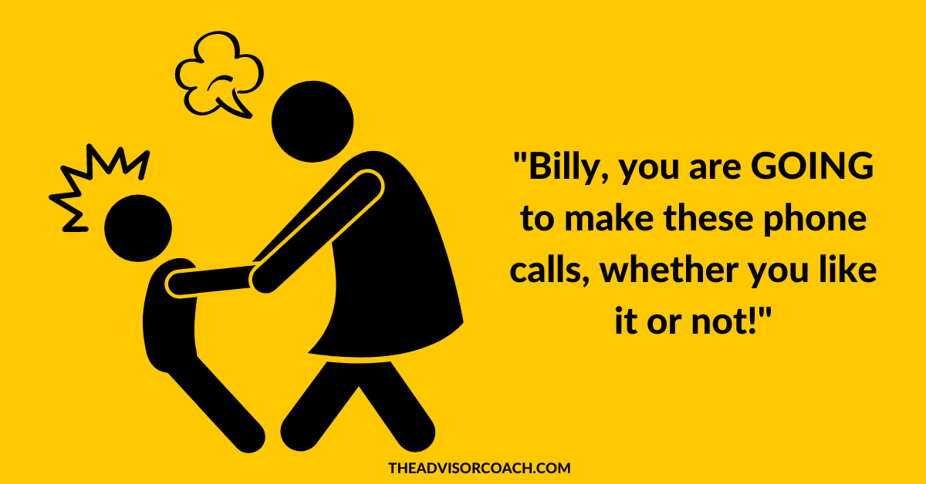
You haven’t practiced enough.
As you gain experience selling, you’ll naturally encounter similar questions, concerns, and problems among your customers and prospects. Additionally, you’ll also begin to get a feel for the different personality types that might be common in your industry.
From these experiences, you gain confidence when navigating similar discussions in the future. These interactions also help reveal where your product or industry knowledge may be lacking, which helps better prepare you to assist customers in solving tough challenges or questions later on.
But if you’re just starting out, or if you’ve let call reluctance take a firm root for too long, you’ll find yourself lacking practice and being out of step with your customers’ problems, needs, and expectations, which can lead to higher rates of rejection.
Every salesperson struggles with call reluctance at some point. Trainers and coaches can help your or your team overcome it, generate higher sales, and build customer loyalty.
Let's Work Together

Slide 22
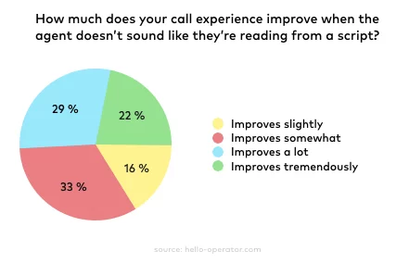
What Are the Signs of Sales Call Reluctance?
Sales call reluctance can manifest itself in a number of detrimental behaviors that, on the surface, may not seem related to your issues with call reluctance at all. By understanding what these behaviors are and how they’re further compounding your problems, you can more effectively chart a course for personal and professional improvement.
Frequent procrastination
Whenever thinking about a certain task fills us with dread, it’s common to feel the urge to procrastinate and put it off until tomorrow.
And procrastination can masquerade as tasks that seem related to our work, such as visiting email or social media sites for messages from prospects, or double-checking CRM information when we should be making sales calls.
But these tasks, when performed during the times when we should be committed to making our sales calls, only hinder us from getting our real work done and ultimately serve to only compound our problems.
If left unchecked, procrastination can erode the trust you’ve built with customers and the lines of communication you’ve established with prospects, turning warm leads ice cold and evaporating your customer’s faith in your ability to help them.

Slide 23
Feeling ashamed of being in sales
“Sales” and “salesperson” are dirty words for some. Just the mention of them can conjure images of manipulative, pushy salespeople and memories of poor customer service experiences.
And these feelings and memories can stay with a person even when they themselves enter into a sales position, causing them to feel like they’ve become the underhanded salesperson that they always dreaded encountering.
With these feelings always at the forefront of their mind, a salesperson who feels ashamed of their role often gravitates away from their responsibility to follow up with their existing customers and contact new prospects.
Over-preparing before your calls
Preparing for your sales calls and properly qualifying prospects is an important aspect of selling. Researching your prospect’s needs, stresses, and other important information ahead of time certainly helps your prospects feel as ease during your call and allows you to more readily address the issues that matter most to them.
However, if you perpetually feel underprepared for your sales calls even after doing all of the necessary research, and you find yourself dedicating more time to preparation than to actually making contact with your prospects and customers, then you’re likely falling into a common form of procrastination known as “overpreparation.”
Though important, your preparation can never guarantee that a call will go perfectly, nor will it ever be able to yield the same amount of information that you could glean by building trust-based relationships with your prospects. And those relationships can only begin to grow if there’s authentic, person-to-person communication.

Slide 24
Not asking for referrals
A happy customer’s word-of-mouth referral is one of the most effective forms of customer acquisition that exists. It helps you generate more sales and your customer is happy that they got to connect their friend or associate to your helpful service.
But if the thought of having another prospect to call fills you with a sense of dread or you’re actively refusing referrals to avoid interactions with prospects, then that’s a surefire sign that your sales call reluctance needs to be corrected before it irreparably damages your customer relationships.
Always anticipating the worst case scenario
It’s true. Sales calls aren’t always easy.
You may have to break bad news to your customer or inform them that you’re unable to help them with the problems that they’re facing. And these types of calls can understandably get heated as the customer now has to deal with yet another problem.
But if you’re finding yourself paralyzed by an endless string of “what-ifs” and you’re stuck in a cycle of thinking about what could go wrong with each call, then that’s a clear sign of call reluctance that you need help with correcting.

Slide 25
How Can Sales Call Reluctance Affect Your Sales Career?
Though sales call reluctance is quite common, it can quickly become a formidable obstacle in your career if you don’t seek out help and take the necessary steps to overcome it.
You significantly damage your potential sales performance.
If you’re hesitant to pick up the phone and make authentic connections with your customers and prospects, your problems will only compound over time.
Feeling abandoned, your customers and prospects will have a difficult time trusting you or the efficacy of the products or service you’re offering. Naturally, they will be far less likely to do business with you, leading to significantly reduced sales.
Additionally, your leads will cool down and eventually begin to dry up completely as you allow these connection opportunities to continually pass you by.
Ultimately, this all leads to an overall decrease in your sales performance and a drastic shrinking of your ability to perform in your role as a salesperson.
You may be passed up for advancement opportunities.
No matter what industry you’re in, if you’re not able to produce a clear and consistent history of achievement, you’re far less likely to be considered when a potential advancement opportunity becomes available.
You may be terminated from your company.
Sales call reluctance significantly deteriorates every aspect of your sales performance and your ability to connect with prospects and existing customers alike.
If left uncorrected, this consistent decline in performance won’t go unnoticed, potentially leading to your employment being terminated.
Sales call reluctance is a normal hurdle in every salesperson’s career. Let’s work together to get you back on track toward higher sales and happier customers.
Overcome Your Call Reluctance

Slide 26

How Salespeople Can Overcome Call Reluctance
Sales reluctance, as we’ve learned so far, can take root due to a multitude of reasons; however, insecurity -- in one form or another -- always plays a leading role in the development of this aversion to rejection.
Equipped with the knowledge that some form of insecurity is at the root of most forms of call reluctance, and that regardless of how we feel, the only true cure for call reluctance is to confront our aversion head-on, we can develop a strategy for overcoming it.

Slide 27
2. Achieve and maintain a deep knowledge of your products or services.
Understanding your company’s products or services doesn’t just allow you to answer prospects’ questions more easily. It also enables you to put forth the heart and mind of servanthood that you must have if you expect to serve your customers ethically.
Having this thorough understanding allows you to realize exactly how you’re helping people, businesses, or whomever your target audience is. You’re able to see first-hand the problems that your customers have, what stresses come from those problems, and how you are uniquely equipped to help solve those problems and continue being a partner for your customers as their success grows.
This instills within you a deep-rooted belief in your products or services and how they bring real help to people in need.
By truly believing in what you sell, you’re able to cast off any feelings of shame you may have had concerning your being a salesperson and you can now work confidently toward helping your customers solve their problems.
Remind yourself that you’re a problem-solver
and a partner.
Many people -- including some salespeople -- see the term “salesperson” and immediately conjure images of dishonest charlatans and other manipulative characters. This is a fairly common experience among newer salespeople and is a leading cause of many cases of call reluctance.
It’s imperative to remind yourself of your true role as a salesperson. Your role is that of a helper, trusted partner, and problem-solver for your customers and prospects.
If you’re going into your calls with the mindset of landing a sale by whatever means necessary, then you’ve already lost and absolutely must correct your course if you expect to find success in the sales industry.
Before each prospect interaction, remind yourself of your true purpose. You are there to be a trusted friend and partner to this person whom you’re about to contact. You are there to help them overcome the challenges and stressors facing them or their business and give them honest, helpful, and actionable insight to address those problems together.

Slide 28

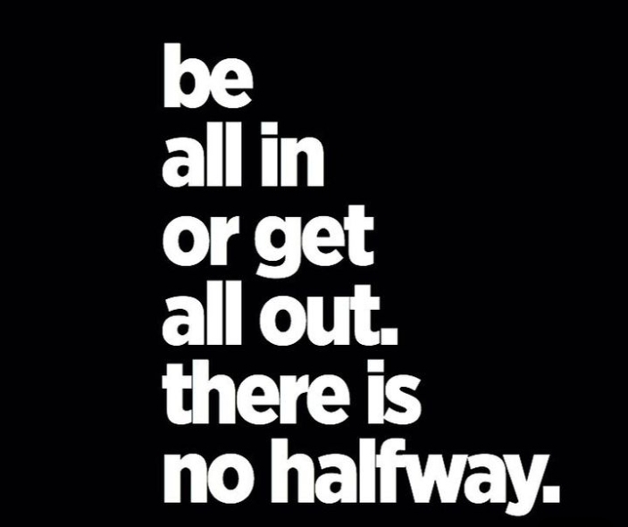

Discipline = freedom
GOTTA DO THE WORK
& BUST THAT DOOR
Freedom is living life on your terms; terms you earn
INSIGHTS THAT EVOLVE US
PREPARE TO WIN
PARTICIPATE
TRAIN
Notes:
You may or may not have wondered,
“Why is team Thrive have a ‘PIRATE” theme ???”
It is my hope that TODAY, you will not only understand, but embrace it and make it part of your core purpose for existence ----- play video

Slide 29
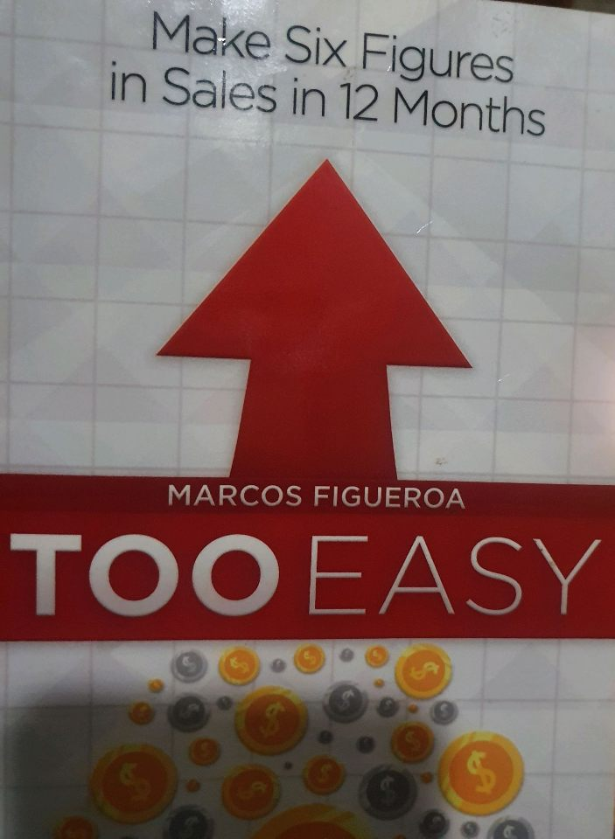
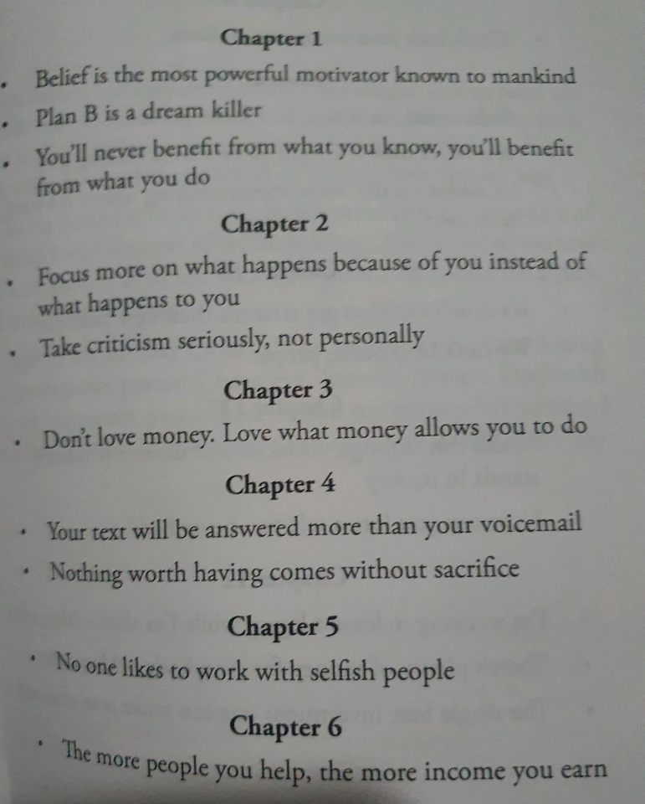
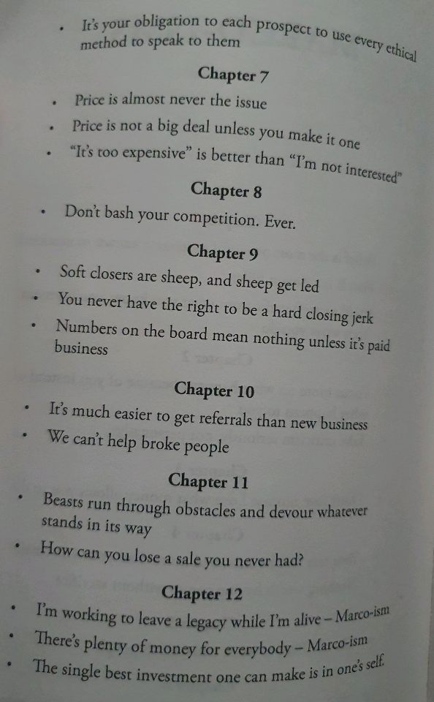

Slide 30
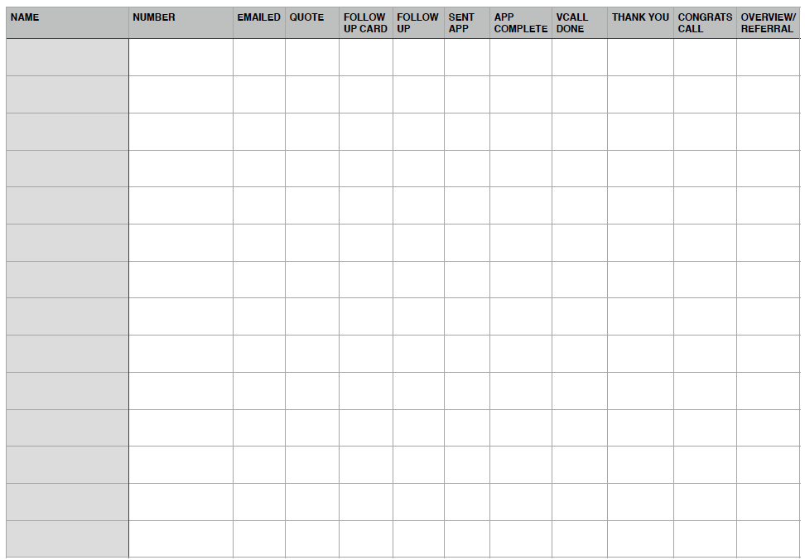
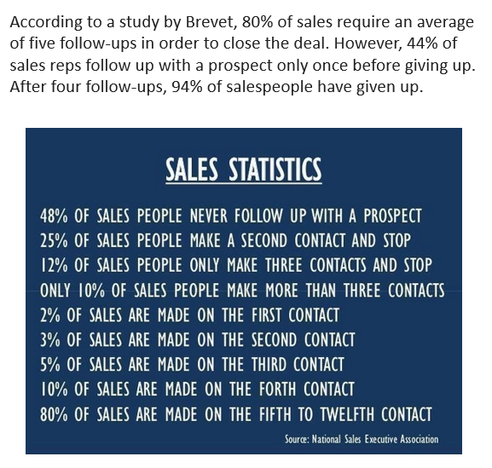

Slide 31
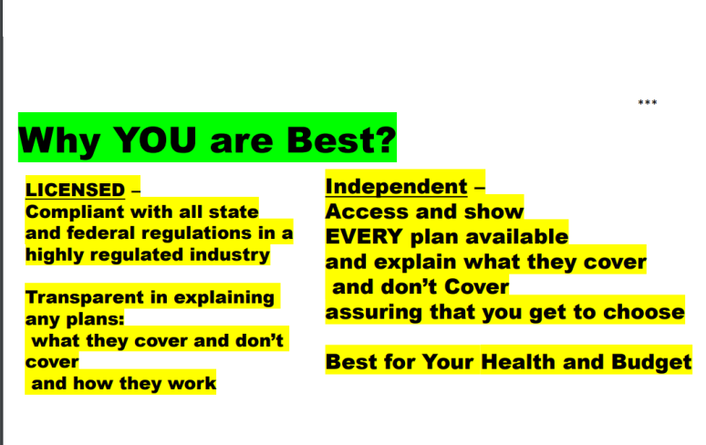
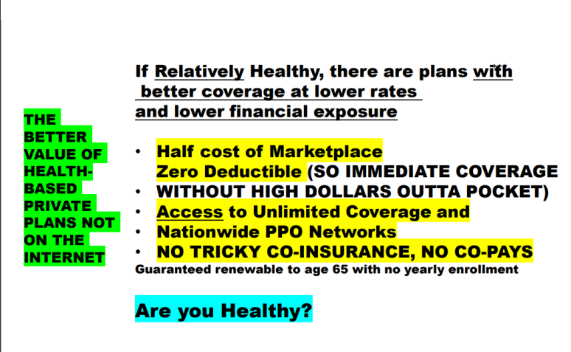

Slide 32
However, do you know the number one reason why a prospect won’t get back to you? It’s not because they are not interested, it’s because they are busy. Decision makers have a lot of conflicting priorities to juggle and many different demands on their time. According to Harvard Business Review, professionals have on average over 200 emails in their inbox at any one time.
In other words, they’re (probably) not ignoring you because they don’t want what you have to offer.
You just need to be tenacious to get their attention because they have a lot going on. Next -, we’ll learn how to perfect the art of the follow-up.

Slide 33

3. Pre-qualify each of your sales prospects.
Qualifying a prospect isn’t just sound sales practice -- it also helps put you into the correct mindset of being a trusted partner and helper. While your industry or organization’s qualification process may vary, the heart of qualifying a prospect lies in answering 4 key questions:
Do they need what I’m selling?
Are they a decision maker?
Can they afford what I’m selling?
Who would I likely be competing with?
Knowing the answers to these questions, coupled with selling from the mindset that your purpose is to be a problem-solver, will help bolster your confidence going in to your calls.

Slide 34
4. Remove distractions from your physical and digital workspace.( and your LIFE ! )
Overcoming your call reluctance will require you to come face to face with the stressful stimuli that you’ve conditioned yourself to avoid.
And, as humans, when we know we have to confront an uncomfortable feeling or action, it makes distractions -- like checking Facebook one more time -- all the more enticing. Knowing this, it’s important that we remove the stumbling blocks from our path before we set out to overcome our call reluctance.
On your desk or workspace, clear everything that’s not relevant to the calls you’re making. By clearing your physical workspace, you free yourself from being affected by outside stimuli that don’t pertain to your sales calls, allowing you to focus purely on being a source of trusted insight to your customers and prospects alike.
Digitally speaking, there are a multitude of productivity and distraction-blocking browser extensions and smartphone apps that can help you stay away from websites and apps that can eat up large portions of your day with fruitless distraction.
Find those which work best for you, install them, and commit your computer and phone to purely being a tool which helps you help your customers.

Slide 35
5. Seek guidance from your sales manager.
It’s natural for salespeople to want to avoid contact with their sales manager when they’re having difficulty with call reluctance. After all, it would be foolish to openly admit to their superior that they’re having difficulty doing a key aspect of their job, right?
This line of thinking couldn’t be any further from the truth. Your sales manager is the first person you should be open and honest with when seeking to address your call reluctance.
Your sales manager, in part, is there to be your coach and help you overcome any challenges that might be in your way when it comes to connecting with prospects, building trust-based relationships, and successfully completing sales.
Be open and honest with your sales manager when you breach this subject. Let them know the outcomes that you’re fearing as well as the steps you’ve taken to start addressing this issue.
In most cases, this won’t be your sales manager’s first time helping a salesperson through call reluctance -- and they have likely had to overcome their own call reluctance when they were a fledgling salesperson!
Being the first to bring this issue to their attention doesn’t demonstrate weakness or inability. Quite to the contrary, this shows your sales manager that you’re committed to improving yourself and, together, you can create an actionable and realistic set of goals to help you overcome your call reluctance.

Slide 36
6. Track your progress after each call.
Before you begin your calls for the day, prepare a spreadsheet or notebook where you can track your progress toward overcoming your sales call reluctance.
In your spreadsheet or notebook, keep a record of the following:
Did I meet my goal for the call?
What went well?
What would I do differently if I did the call over?
What is the next step?
By keeping a record of your calls, you provide yourself with concrete proof that you are capable of pushing through your feelings of fear and dread in order to accomplish your goals. (protects compliance)
Additionally, it empowers you to continually improve after each all, correcting weaknesses as you continue through your call list, thereby making each call less intimidating.
Be sure to review this list with your sales manager or professional sales coach. During your time together, don’t be afraid to ask any tough questions that arose from your latest call sessions. This is your opportunity to take the hurdles you’ve encountered, learn from them, and turn them into actionable tools you can use to become a better, more confident salesperson.

Slide 37
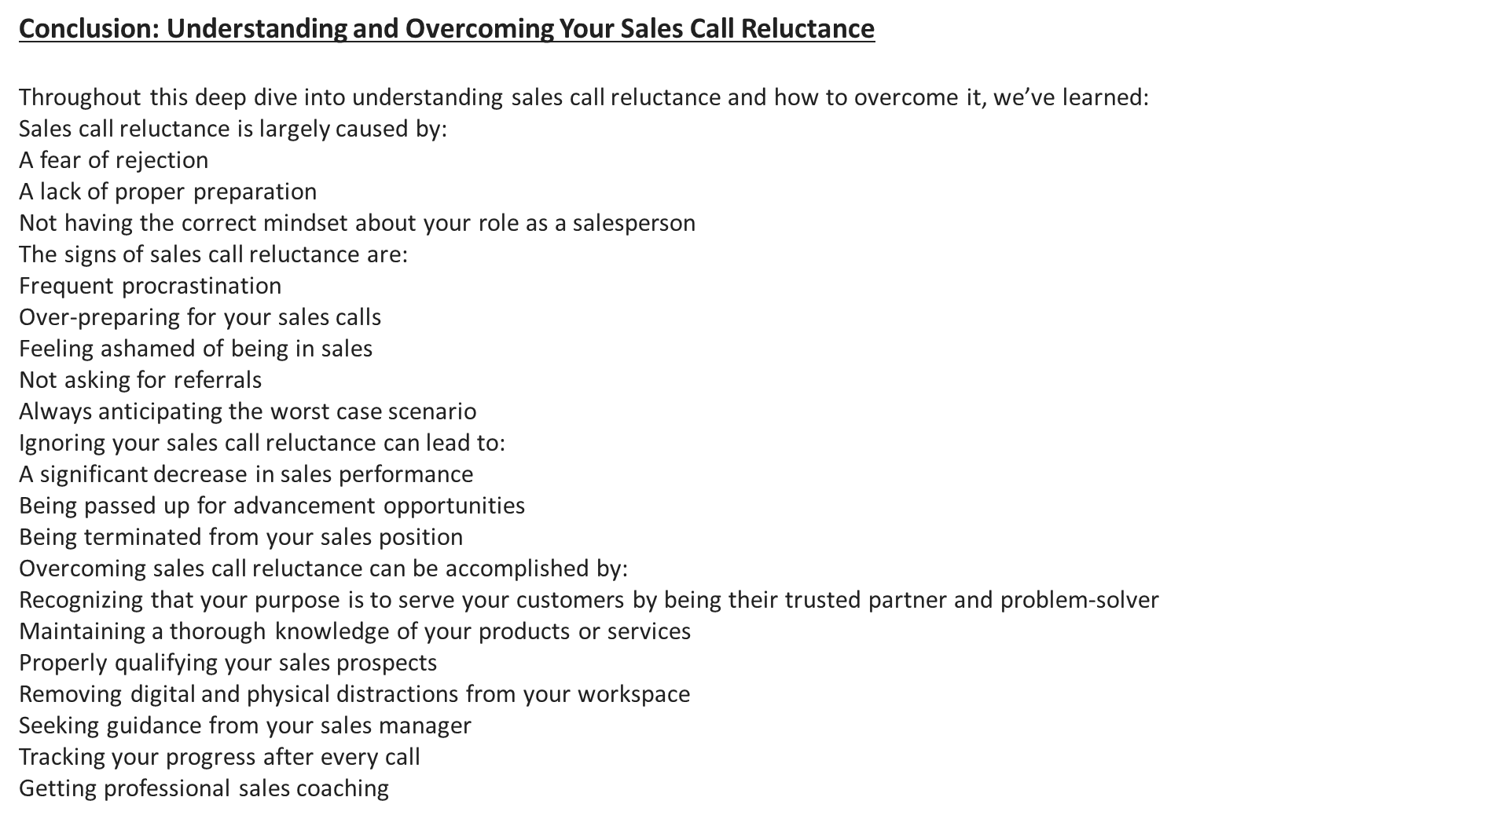
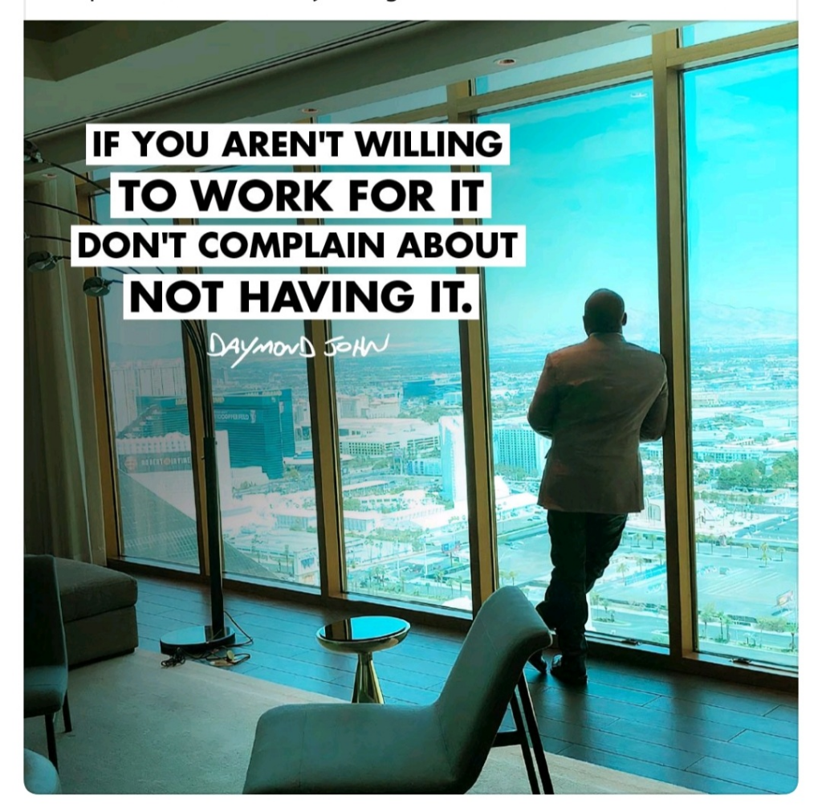

Slide 38
You just need to be tenacious to get their attention because they have a lot going on. Learn how to perfect the art of the follow-up. Be Bold ADD VALUE
Call reluctance is rooted in natural human emotion and it’s a part of nearly every salesperson’s journey -- especially when they’re first starting out. What’s important to remember is that you do possess the ability to understand the nature of your call reluctance and develop a plan for success

Slide 39

See the need For Success as Highest Priority.
Do it for 10 minutes
SEAL Recovery
Execute an Aw Fuk-It Call
Mindset , Future Picture. Goal Setting.
Goal Declaration.
Attitude difference
Excitement/ Danger
Fear / Bold Courage
Trying / Doing

Slide 40

Personal Goals
Team goals
Smart Goals
Divey-Up & Conquer
How to Live your Best Life
PTSD
How to reach your goal
Your Why
Your Future picture
Your Desire and Scarifice
Close the gap
Apply best technique / Use best gear
Never give-in, Always keep Moving
Happy=
progressive action toward goals
with achievements in process

Slide 41
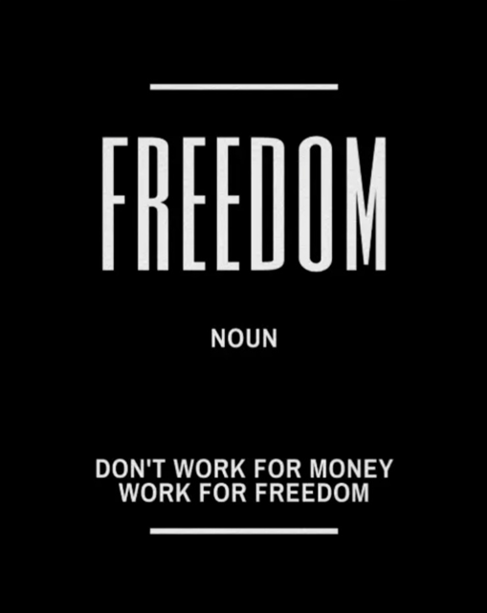
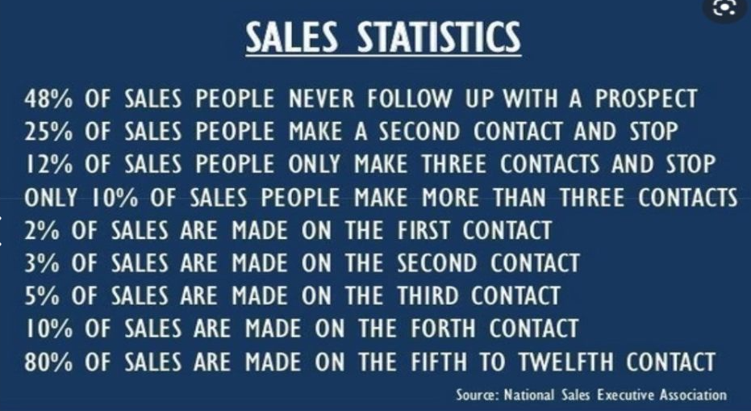
Advanced Agent Training
Training resources Library
Communications
Compliance
Follow Up game
The Portal
ACA Law
Employer Plans
Small Business
Application Oddities
UHCC USHA Plans
Competition
Data Scrubbing
Claims

Slide 42
Additional Training -Advanced
Goals / Scheduling
March 2021 Covid Relief Act
Advanced Prospecting and Follow Up
Ghost- Busting / Tighten the Appointment
State Variations
Prescription/ Medical Programs
Employer Tax Savings Tools
The Associations
Networks
Medication/ Condition Underwriting- Advanced
Social Media
Toughest Objections
Nuggets Good To Know
Sideline / Mighty Text / Pulse / Burners
Call Reluctance
Mindset & Newton’s Laws
Premier Choice / Premier Med / MedGuard
Health Access and HA-2
Secure Access
CIA ( Critical Illness and Accident)
Getting Paid / Building Wealth
Exact Phrases / Advanced Selling
Better Life Manifestation
Advanced V-Soft/ Connect Me Voice
Health Insurance Industry Terms, Explanations, Variations
Back to the Script- Advanced
Screenshares-Advanced
I-Sales CRM Basic and Advanced
Short Terms and Limited Benefits and Share Plans
P-Notes/ Banking Information
Call Reluctance Remedy
BBB King Plus

